Slide 1
Project ROUTE-Step Up
Data Science and AI challenge
Can we trust the ride? When Autonomous vehicles take the Drive
Kunmira Yantavej
3rd Year BSc Computer Science
Newcastle University

Slide 2
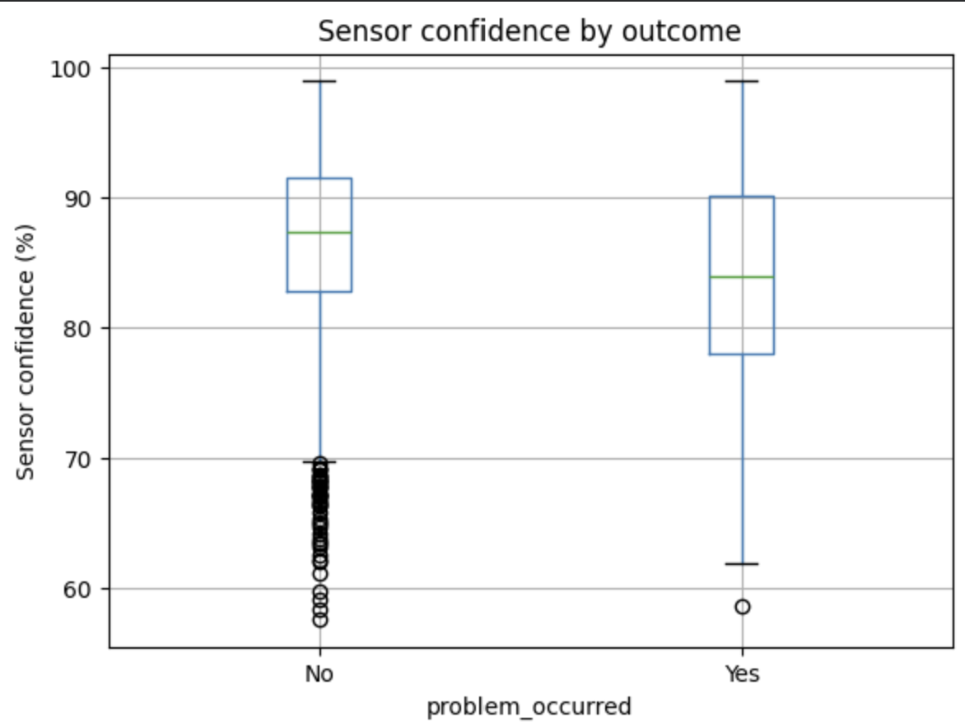
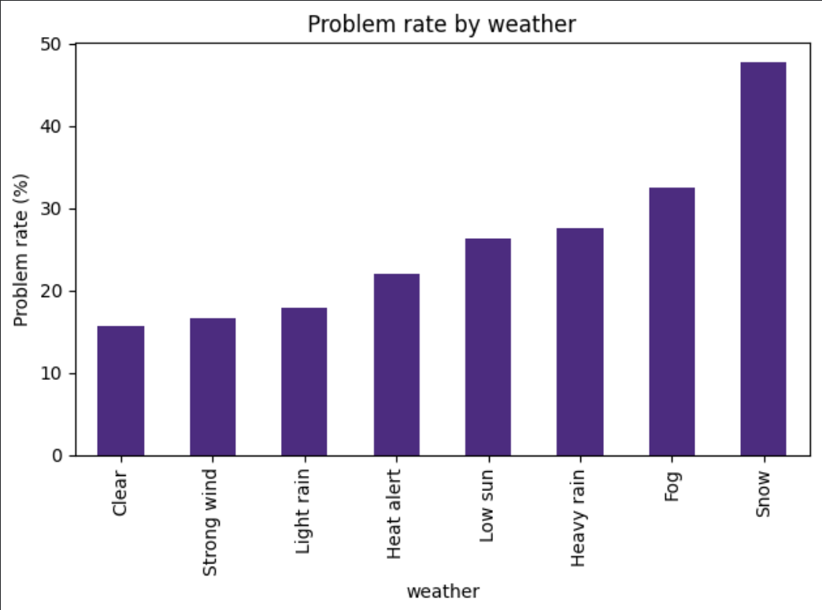
Patterns in the data
Patterns:
- Problems occurred more frequently when there are extreme weather
- Clear weather have the lowest problem rate, while snow have the highest problem rate.
Limits:
- It doesn’t account for other variables like road types, distance, traffic level etc. which could potentially be other causes of factors for why problems occur
Patterns:
- High sensor confidence - less problem occurred on average
- Low sensor confidence – high problem occurred on average
Limits:
- The high number of sensors with no problem occurred might not have taken into account the fact that some sensors could potentially malfunction, resulting in problems not being detected or recorded, which then registered as no problems occurred.

Slide 3
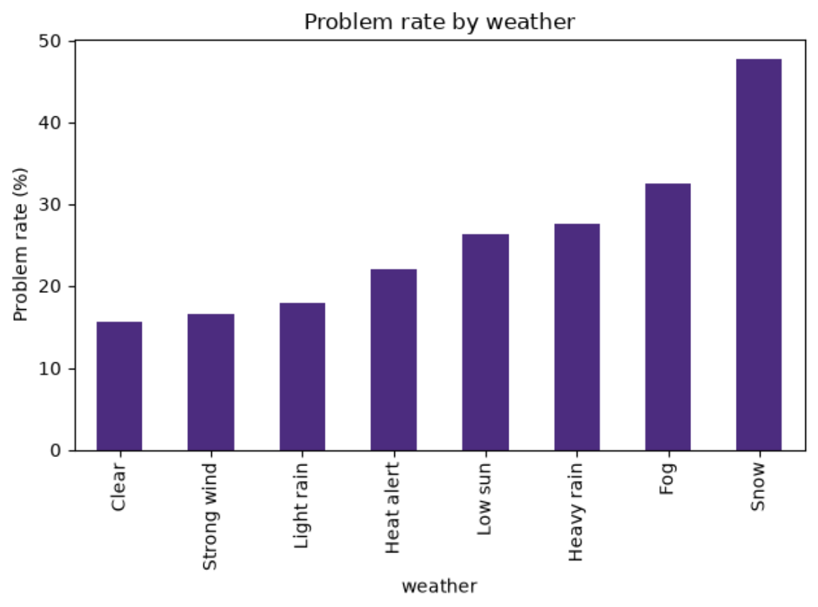
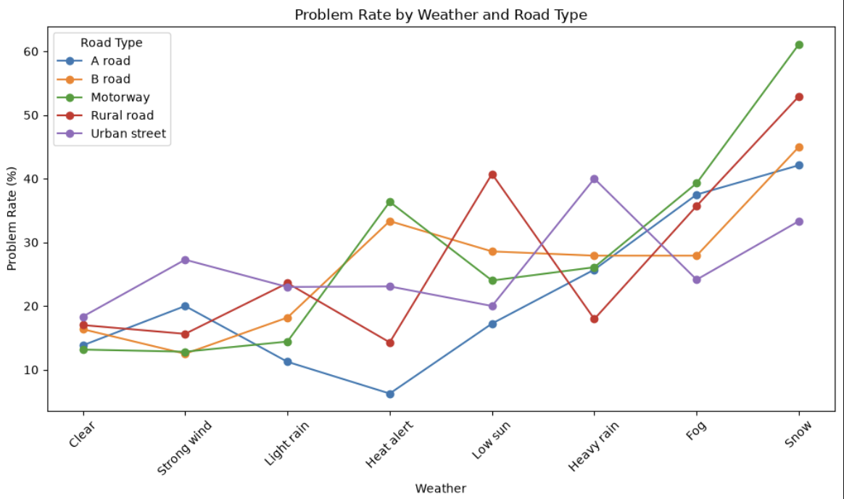
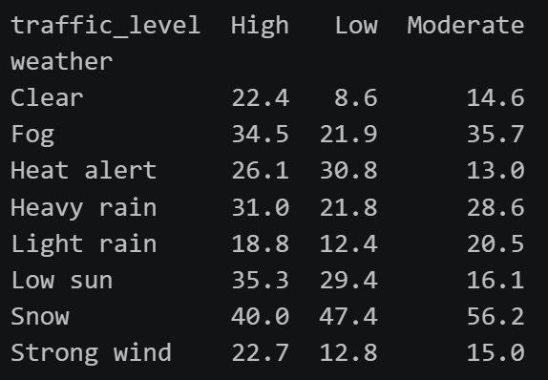
Key factors
Weather
Sensor Confidence
Weather, especially snow and fog, is one of the important factors. The problem rate by weather chart supports this, with problem rate being 47.7% in snow, 32.5% for fog, while clear weather is 15.7%. Additionally, the problem rate by weather and road type and weather by traffic visualizations also supports this. Snow remains high across traffic levels (40%-56.2%) and road types (33.3% - 61.1%). Fog also remains second highest across traffic levels (34.5%-35.7%) and road types (24.1% - 39.3%).
Sensor confidence appears to be another important factor. Lower sensor confidence is more associated with problem occurred, with a median of about 83%, while higher sensor confidence is more associated with no problem occurred, with a median of about 87%.

Slide 4
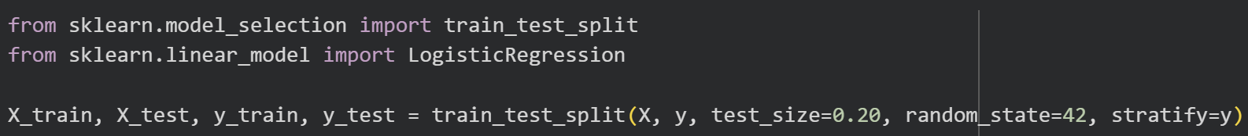
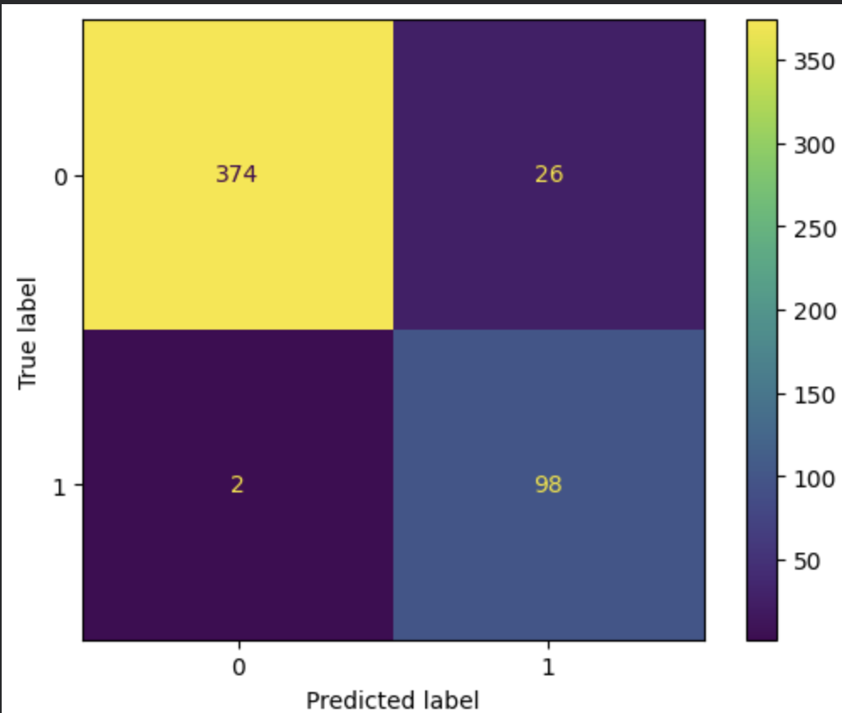
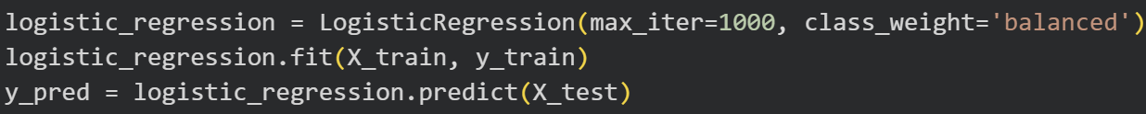
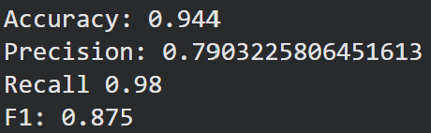
Prediction and Evaluation
80/20 train-test split. 80% train set. 20% test set
Confusion Matrix
Model used: Logistic Regression
Metrics:
94% accuracy - 94% predictors were correct overall
79% precision – 79% right when predicting a problem
98% recall – 98% real problems detected
87% f1-score – precision and recall have very good balance
Confusion matrix:
True Positive – 374: There was a problem, the model correctly predicted 374 times that there was a problem
False Negative – 26: There was a problem, the model incorrectly predicted 26 times that there was no problem.
False Positive – 2: There was no problem, the model incorrectly predicted 2 times that there was a problem
True Negative – 98: There was no problem, the model correctly predicted 98 times that there was no problem
False alarms and missed problems
A false negative is a missed problem. From the confusion matrix, the model predicted 26 times that there was no problem, even though there was a problem, so this can be dangerous as the model missed a real problem.
False alarm means false positive. This is when there was no problem but the model predicted that there was a problem, too many false alarms will cause people to stop trusting it.
Want high recall and low false negative and positive, which the model is achieving this quite well looking at the results (with 98% recall).

Slide 5
AI improvements and ethics
AI improvements | Recommendation
Extreme Weather have high problem rates. AI could help users identify journeys that might need extra checks or suggests different paths in extreme weather | Review the highest-risk factors first. Human operators should check for factors that are involved in a journey that causes high problem rates and high risks, such as extreme weather (snow and fog), dangerous road types (rural or motorways), etc.
The model caught most problem journeys. Use it as an early warning, this could help draw attention to journeys that might otherwise be missed. | Before relying on a model, test it on journeys with different routes, vehicles or dates to see whether the model still works or not.
The system should support a human decision, and not automatically cancel or reroute journeys. | The model still have some false alarms and missed problems; humans should still monitor, review and compare thresholds.
Problem rates differed across sensor suites and software versions. AI could help identify factors for investigation and improve sensor and software performance. | Compare sensor performance and software versions. Investigate findings and determine which factors causes poor sensor or software performance, don’t replace a system immediately just because it did horribly.
Ethical risks and safeguards
Uneven performance: The data may not represent every route or condition. Test results separately across road and weather groups, and be cautious when a factor/features has few journeys.
False alarms or missed problems: Keep a human involved, be aware that the score is a warning rather than a certainty, and monitor false alarms and missed cases.
Privacy: Limit journey and sensor data to what is needed, restrict access, and remove identifying details where possible.

Slide 6
Trust Decision
Yes, but not entirely.
I would not blindly trust everything it says, but rather use it as a recommendation or helper instead.
Model Limitations:
The model can miss some patterns. Logistic regression is simple but it might miss complicated combinations of conditions
The model caught 98% (recall) of real problem journeys in the test set, but it was right about 79% (precision) of the time. This means some warnings are false alarms (2 times of false alarms).
The model shows correlation, not causation. For example, a feature associated with more problems isn’t necessarily the reason those problems happened.
Data Limitations:
The data only have 2500 journeys, which might not be enough for real-world journeys, such as varieties of different roads, vehicles, weather, or unusual situations are quite limited.
Some categories might have fewer examples. This could mean that a high problem rate in a category could be misleading.
Data is synthetic, it doesn’t represent real-world journeys. As the model is trained on these synthetic data, it should not be used in real world operational use.
Further evidence:
There should be more journeys from different routes, vehicles, weather, and dates, especially difficult and unusual conditions.
A separate test using new journeys from different dates or routes, not used to build the model. To test whether the model works on these new journeys.
- Test different warning thresholds, showing how many problems are caught, which are missed and how many false alarms occur.

